Slide 1
Support Vector Machines
Lee-Ad Gottlieb

Slide 2

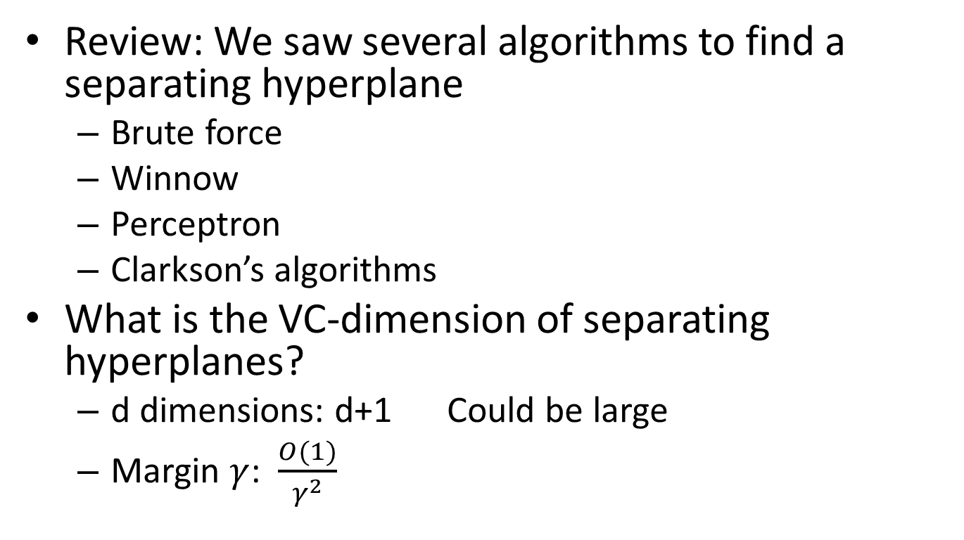

Separating hyperplanes
Review: We saw several algorithms to find a separating hyperplane
Brute force
Winnow
Perceptron
Clarkson’s algorithms
What is the VC-dimension of separating hyperplanes?
d dimensions: d+1 Could be large
Margin $γ$: $\frac{O(1)}{γ^{2}}$
$$γ$$
$$γ$$

Slide 3
Overfitting
Why is high VC-dimension bad
Like memorizing…
Overfitting
Learning the sample, not understanding the underlying rule behind the sample

Slide 4
Hard-margin SVM
Suppose the data is separable
We want to find a hyperplane separating the points with large margin
A hard margin is consistent with S
A solution was given by Vapnik (with others) in 1990’s, while he was at Bell Labs, AT&T.
Support Vector Machines

Slide 5

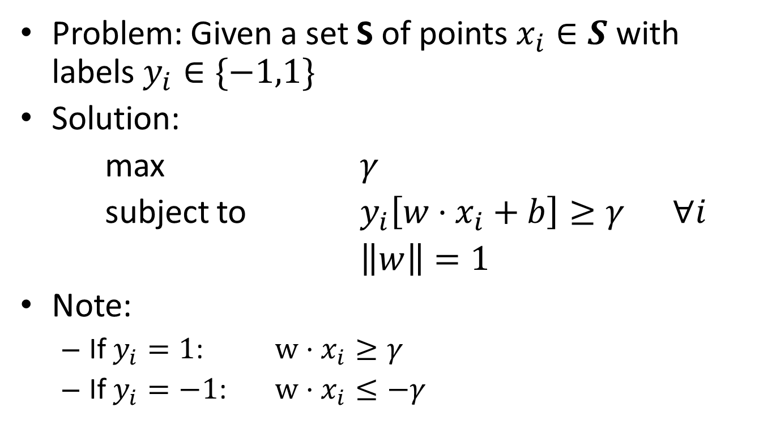



Hard-margin SVM
Problem: Given a set S of points $x_{i}∈S$ with labels $y_{i}∈\{−1,1\}$
Solution:
max $γ$
subject to $y_{i}\left[w⋅x_{i}+b\right]≥γ ∀i$
$\left\|w\right\|=1$
Note:
If $y_{i}=1$: $w⋅x_{i}≥γ$
If $y_{i}=−1$: $w⋅x_{i}≤−γ$
$$γ$$
$$1$$
-$γ$
-$1$

Slide 6
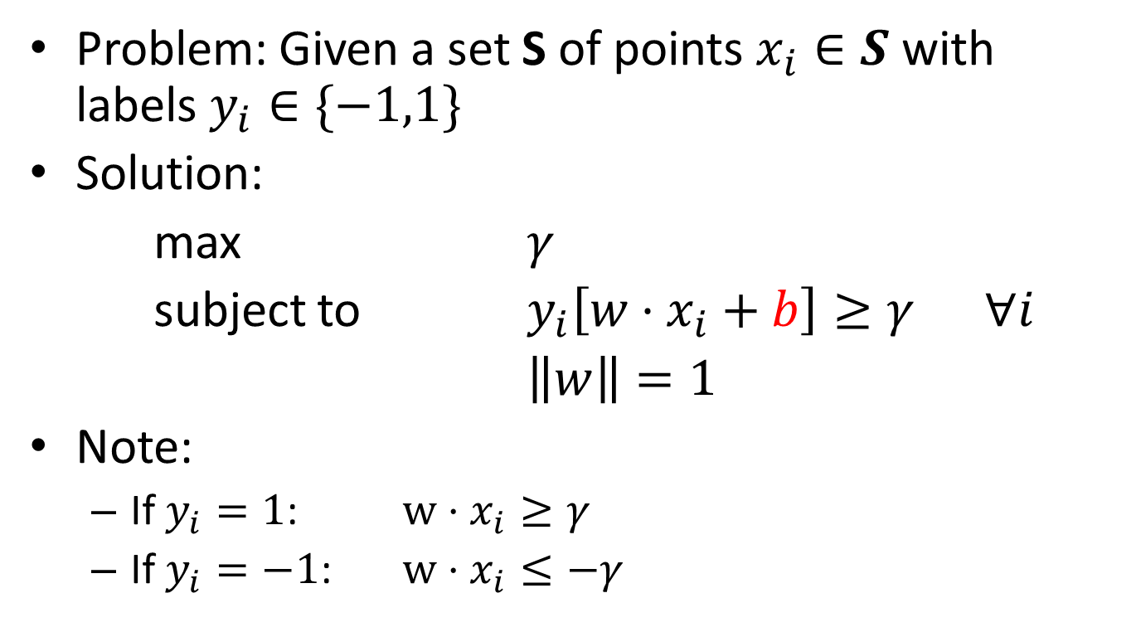
Hard-margin SVM
Problem: Given a set S of points $x_{i}∈S$ with labels $y_{i}∈\{−1,1\}$
Solution:
max $γ$
subject to $y_{i}\left[w⋅x_{i}+b\right]≥γ ∀i$
$\left\|w\right\|=1$
Note:
If $y_{i}=1$: $w⋅x_{i}≥γ$
If $y_{i}=−1$: $w⋅x_{i}≤−γ$
b can be left out.
Then hyperplane goes through the origin
$$γ$$
$$1$$
-$γ$
-$1$

Slide 7
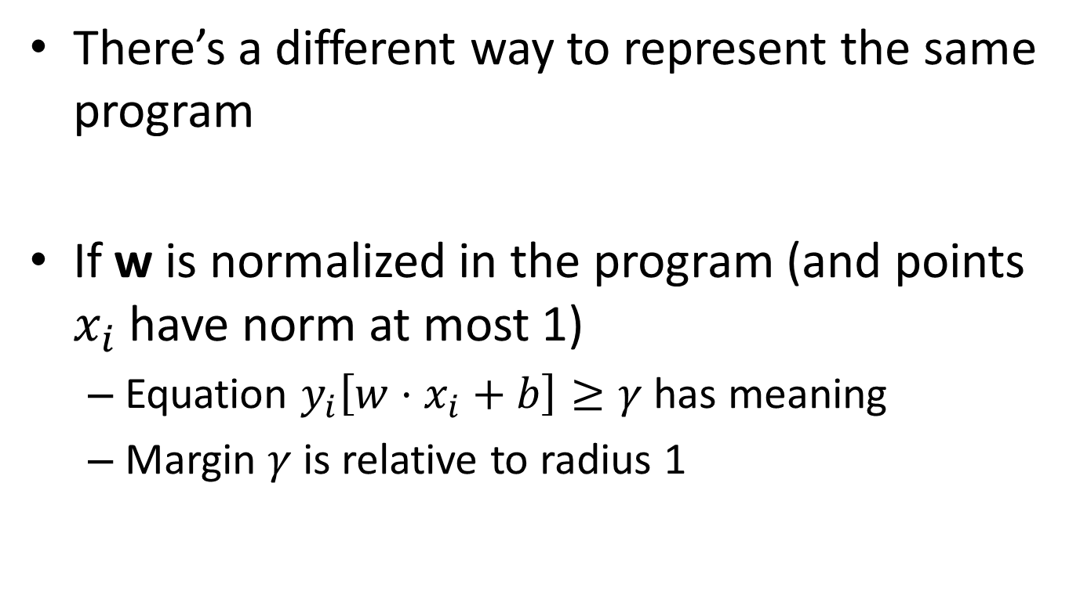

Hard-margin SVM
There’s a different way to represent the same program
If w is normalized in the program (and points $x_{i}$ have norm at most 1)
Equation $y_{i}\left[w⋅x_{i}+b\right]≥γ$has meaning
Margin $γ$is relative to radius 1
$$γ$$
$$γ$$

Slide 8
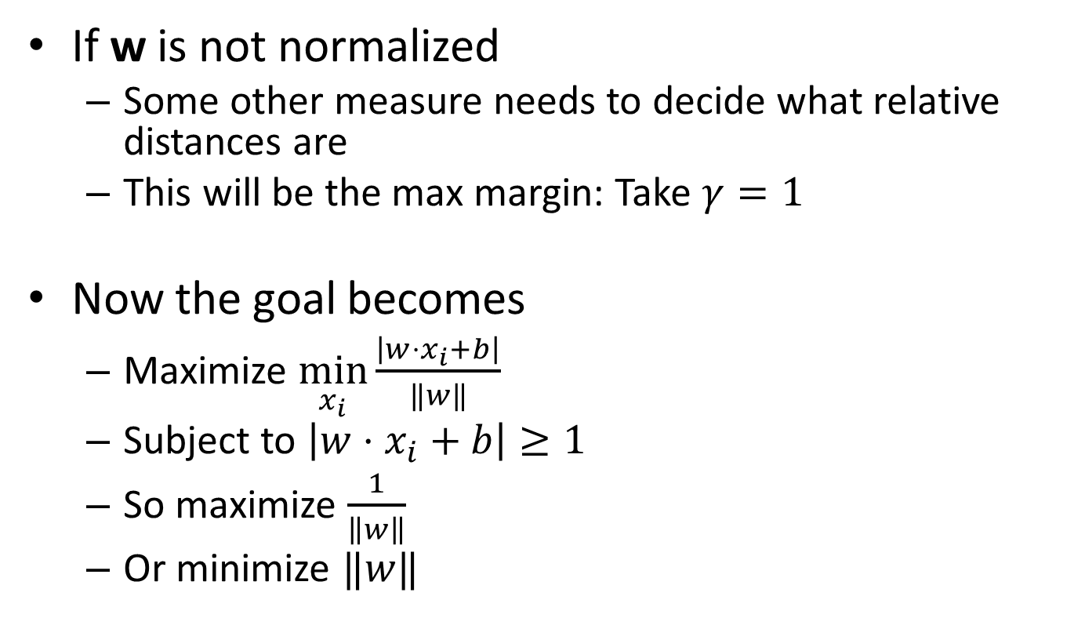
Hard-margin SVM
If w is not normalized
Some other measure needs to decide what relative distances are
This will be the max margin: Take $γ=1$
Now the goal becomes
Maximize $\min_{x_{i}}{\frac{\left|w⋅x_{i}+b\right|}{‖w‖}}$
Subject to $\left|w⋅x_{i}+b\right|≥1$
So maximize $\frac{1}{\left\|w\right\|}$
Or minimize $‖w‖$
$$γ$$
$$γ$$

Slide 9

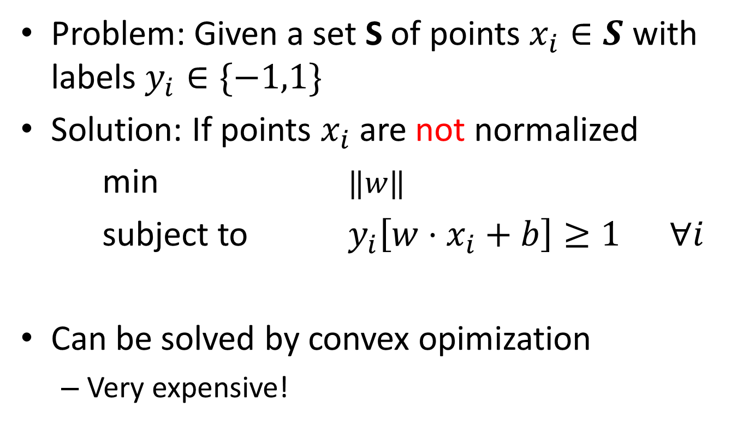

Hard-margin SVM
Problem: Given a set S of points $x_{i}∈S$ with labels $y_{i}∈\{−1,1\}$
Solution: If points $x_{i}$are not normalized
min $‖w‖$
subject to $y_{i}\left[w⋅x_{i}+b\right]≥1 ∀i$
Can be solved by convex opimization
Very expensive!
$$1$$
$$1$$
-$1$
-$1$

Slide 10
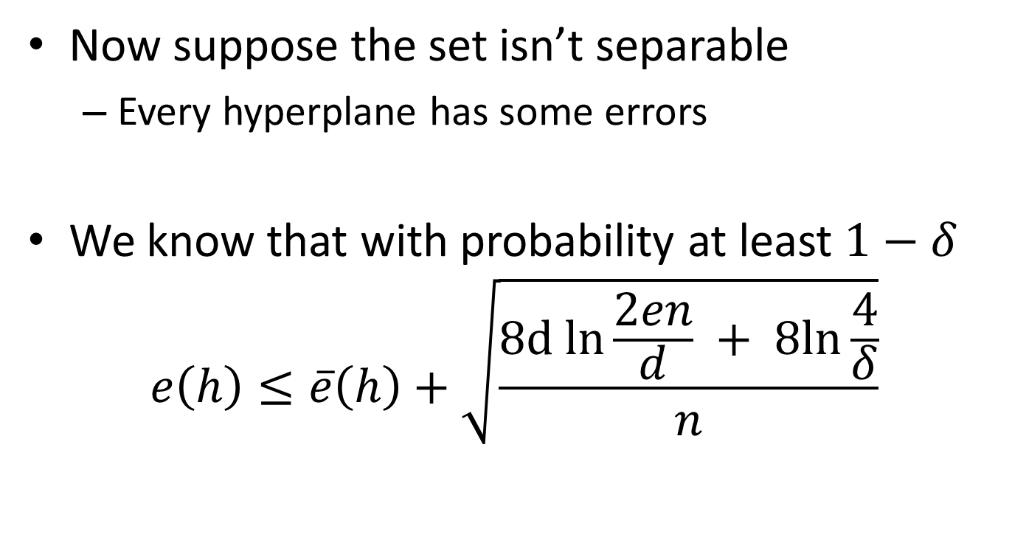
Margin with error
Now suppose the set isn’t separable
Every hyperplane has some errors
We know that with probability at least $1−δ$
$$e\left(h\right)≤\overline{e}\left(h\right)+\sqrt{\frac{8d ln{\frac{2en}{d}} + 8ln{\frac{4}{δ}}}{n}}$$

Slide 11
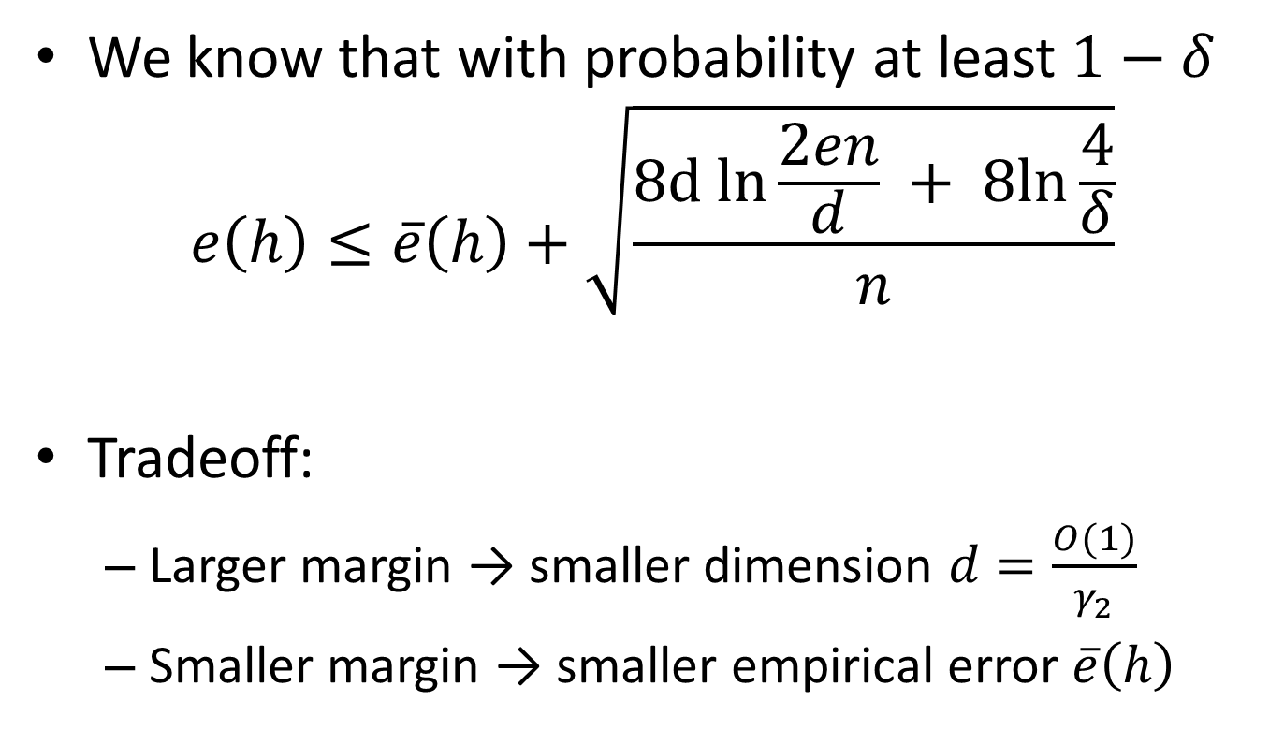
Margin with error
We know that with probability at least $1−δ$
$$e\left(h\right)≤\overline{e}\left(h\right)+\sqrt{\frac{8d ln{\frac{2en}{d}} + 8ln{\frac{4}{δ}}}{n}}$$
Tradeoff:
Larger margin → smaller dimension $d=\frac{O(1)}{γ_{2}}$
Smaller margin → smaller empirical error $\overline{e}\left(h\right)$

Slide 12
Margin with error
For the same hyperplane, we can consider different margins
The wider margin has higher empirical error (all points falling in the margin)
but lower VC-dimension

Slide 13
Minimizing errors
Let S be a set of n d-dimensional points
Problem:
Given S
Find a (d-1)-dimensional hyperplane with as few errors as possible.
Claim: NP-hard

Slide 14
Minimizing errors
Proof: Reduction from Min Vertex Cover
Vertex cover:
Input: a graph G=(V,E) of vertices V and edges E
Output: the smallest subset of V which covers all edges
Classic NP-hard problem

Slide 15



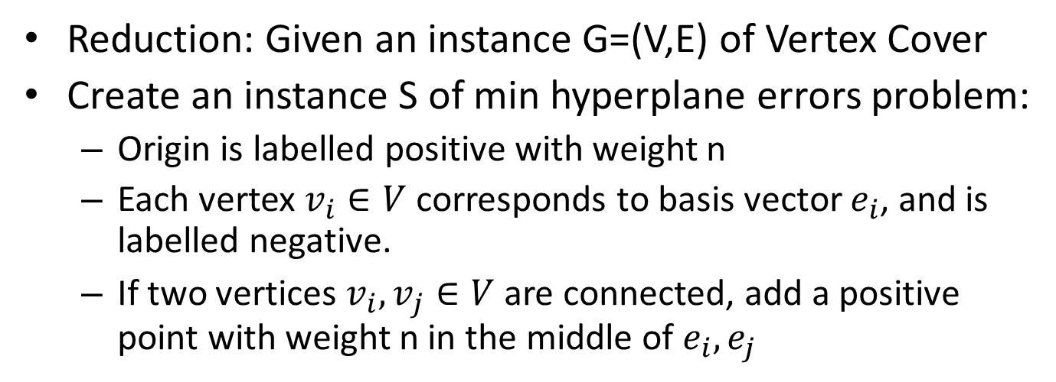




Minimizing errors
Reduction: Given an instance G=(V,E) of Vertex Cover
Create an instance S of min hyperplane errors problem:
Origin is labelled positive with weight n
Each vertex $v_{i}∈V$ corresponds to basis vector $e_{i}$, and is labelled negative.
If two vertices $v_{i}, v_{j}∈V$ are connected, add a positive point with weight n in the middle of $e_{i},e_{j}$
$$e_{2}$$
$$v_{3}$$
Hyperplane
separation
Vertex cover
$$e_{3}$$
$$v_{1}$$
$$v_{2}$$
$$e_{1}$$
$$\vec{0}$$

Slide 16
Minimizing errors
Claim: In the reduction, the following are equivalent:
a hyperplane erring on k<n points in P
A vertex cover for G of size k
Back to SVM…

Slide 17
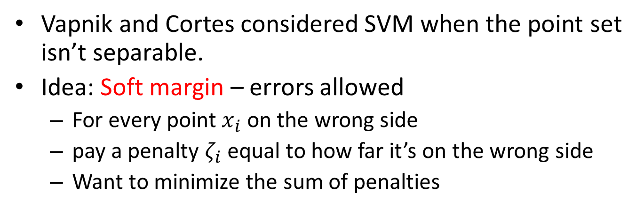
Support Vector Machines
Vapnik and Cortes considered SVM when the point set isn’t separable.
Idea: Soft margin – errors allowed
For every point $x_{i}$ on the wrong side
pay a penalty $ζ_{i}$ equal to how far it’s on the wrong side
Want to minimize the sum of penalties

Slide 18
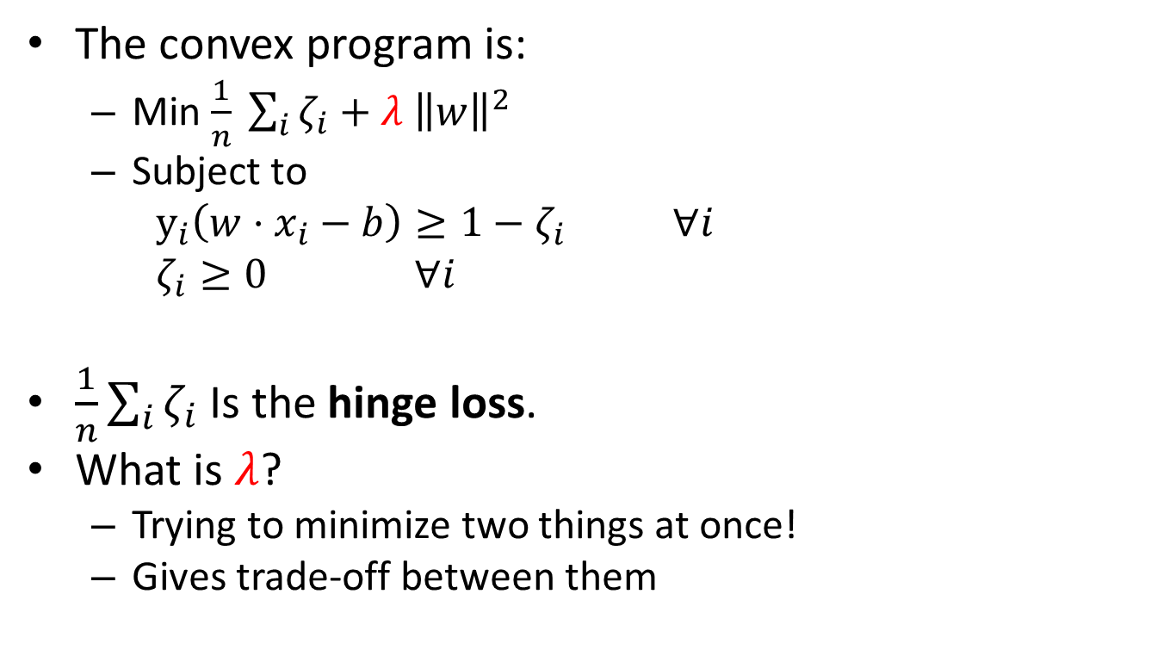
Soft margin SVM
The convex program is:
Min $\frac{1}{n} \sum_{i}{ζ_{i}+λ {\left\|w\right\|}^{2}}$
Subject to
$y_{i}\left(w⋅x_{i}−b\right)≥1−ζ_{i}$ $∀i$
$ζ_{i}≥0$ $∀i$
$\frac{1}{n}\sum_{i}{ζ_{i}}$Is the hinge loss.
What is $λ$?
Trying to minimize two things at once!
Gives trade-off between them

Slide 19
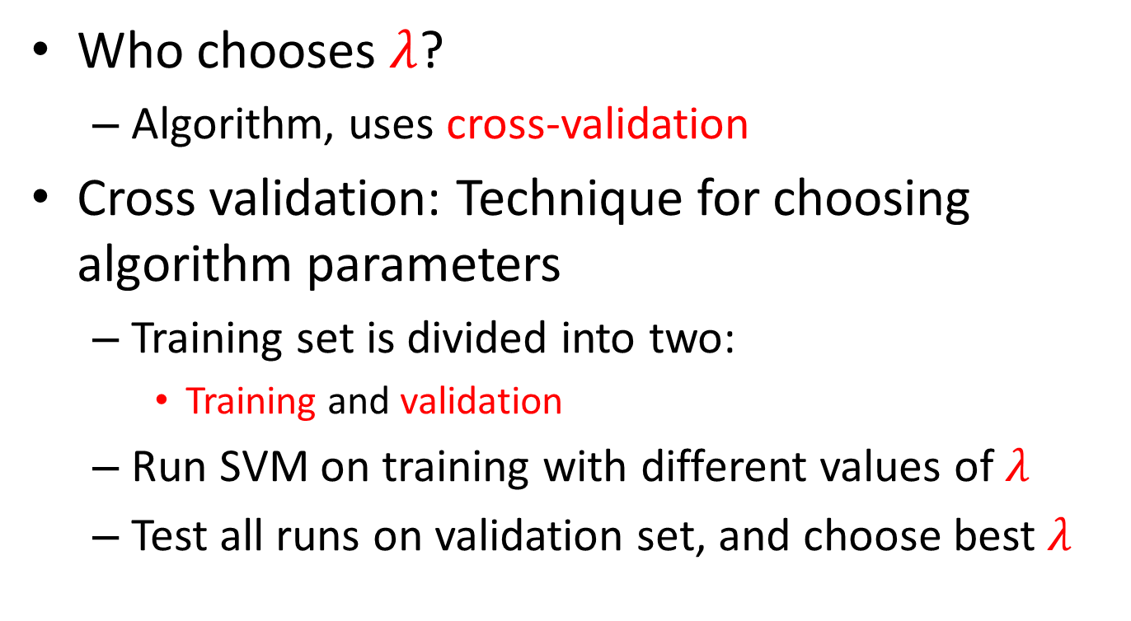
Soft margin SVM
Who chooses $λ$?
Algorithm, uses cross-validation
Cross validation: Technique for choosing algorithm parameters
Training set is divided into two:
Training and validation
Run SVM on training with different values of $λ$
Test all runs on validation set, and choose best $λ$

Slide 20
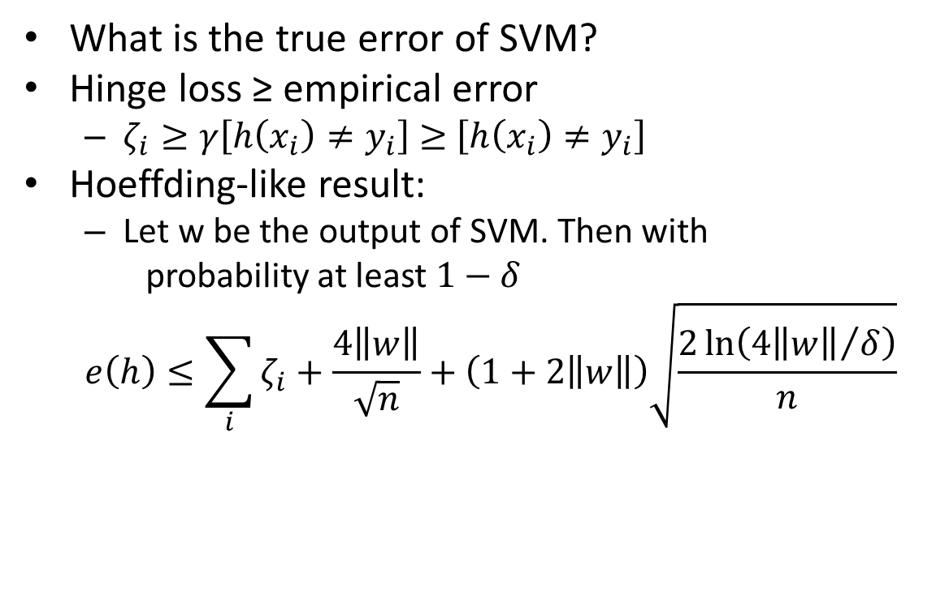
Generalization bounds
What is the true error of SVM?
Hinge loss ≥ empirical error
$ζ_{i}≥γ\left[h\left(x_{i}\right)≠y_{i}\right]≥$ $\left[h\left(x_{i}\right)≠y_{i}\right]$
Hoeffding-like result:
Let w be the output of SVM. Then with
probability at least $1−δ$
$$e\left(h\right)≤\sum_{i}{ζ_{i}}+\frac{4\left\|w\right\|}{\sqrt{n}}+\left(1+2\left\|w\right\|\right)\sqrt{\frac{2\ln\left({4\left\|w\right\|}/δ\right)}{n}}$$
Bounds
Empirical
error

Slide 21
Non-linear SVM
What if we want a separator that’s not a hyperplane?
Not linear.

Slide 22
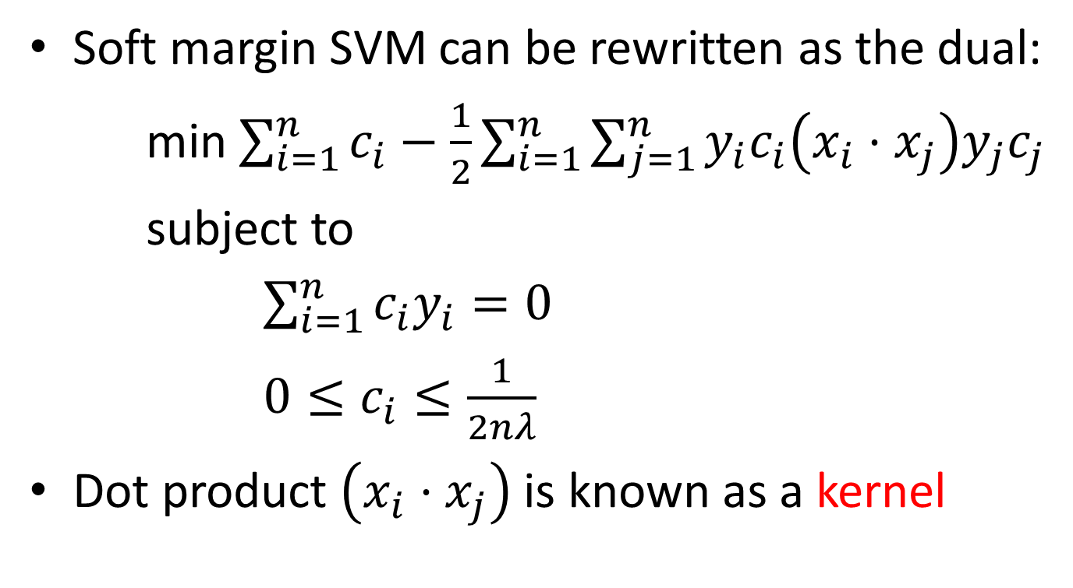
Non-linear SVM
Soft margin SVM can be rewritten as the dual:
min $\sum_{i=1}^{n}{c_{i}}−\frac{1}{2}\sum_{i=1}^{n}{\sum_{j=1}^{n}{y_{i}c_{i}\left(x_{i}⋅x_{j}\right)y_{j}c_{j}}}$
subject to
$\sum_{i=1}^{n}{c_{i}y_{i}=0}$
$0≤c_{i}≤\frac{1}{2nλ}$
Dot product $\left(x_{i}⋅x_{j}\right)$ is known as a kernel

Slide 23
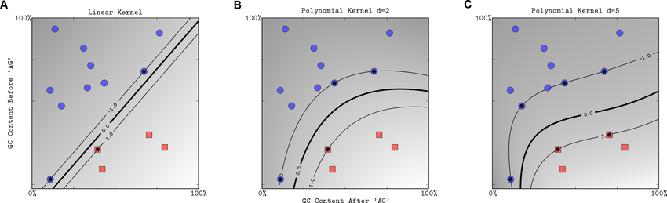
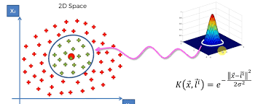
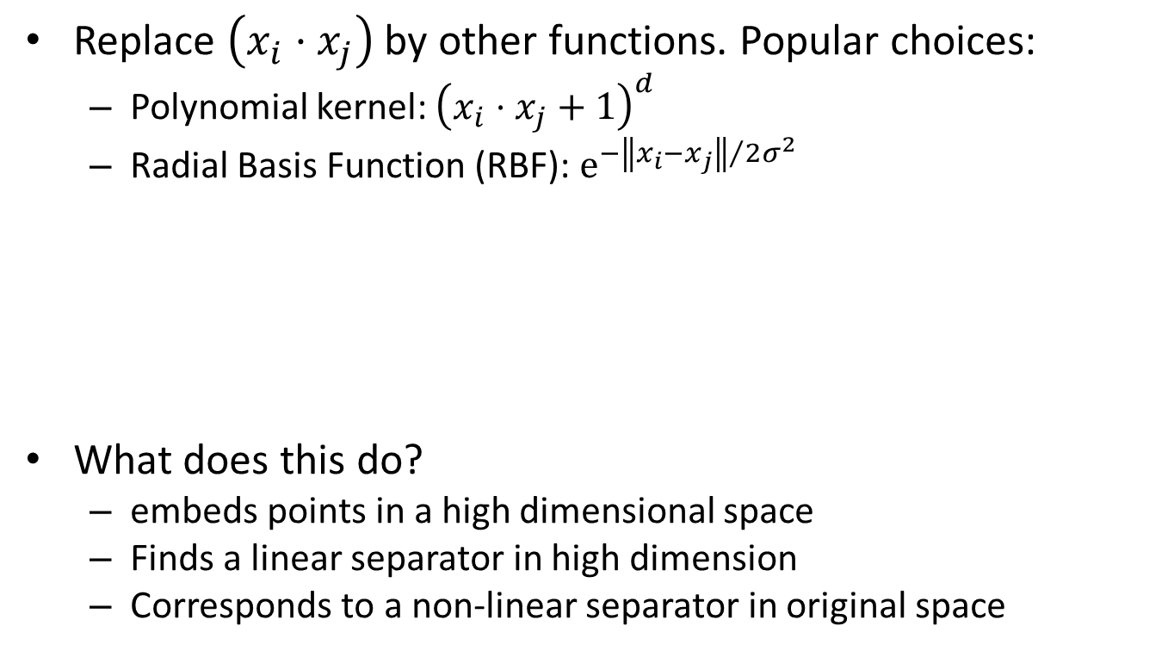
Non-linear SVM
Replace $\left(x_{i}⋅x_{j}\right)$ by other functions. Popular choices:
Polynomial kernel: ${\left(x_{i}⋅x_{j}+1\right)}^{d}$
Radial Basis Function (RBF): $e^{{−\left\|x_{i}−x_{j}\right\|}/{2σ^{2}}}$
What does this do?
embeds points in a high dimensional space
Finds a linear separator in high dimension
Corresponds to a non-linear separator in original space

